Slide 1

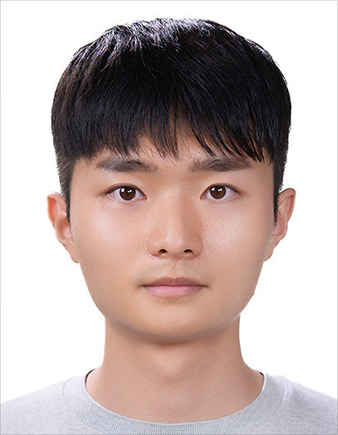
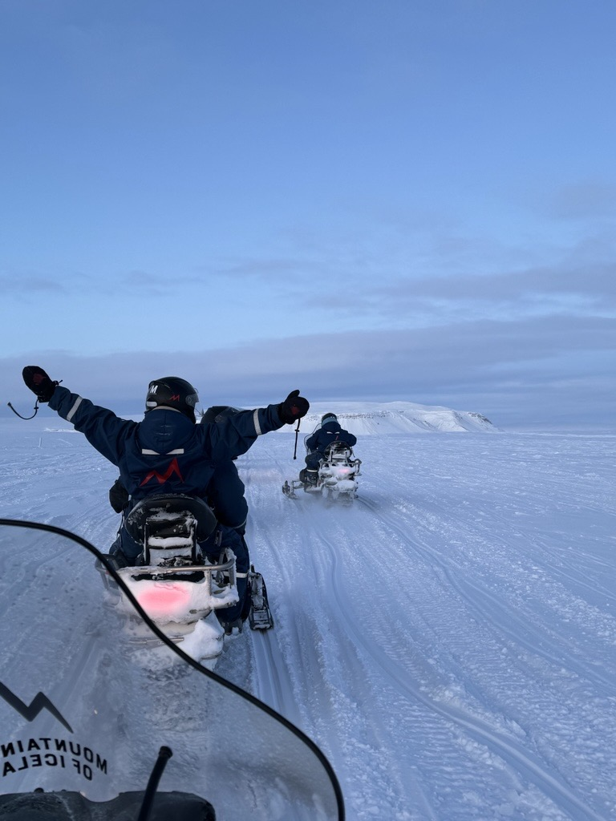
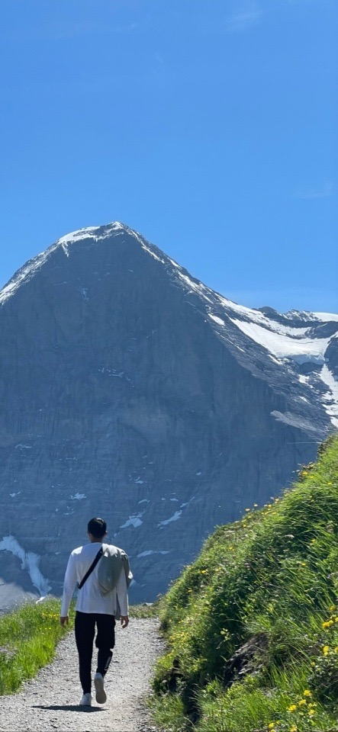

Education
B.Sc in Computer Engineering, Kyungpook National University
Experience
Project_X 대구 제 2기_대구디지털혁신진흥원
Intern_Valeo Mobility Korea
박 준 규

